Slide 1


CAPSTONE PROJECT
genai code reviewer
Presented By
Student Name: SURESH KUMAR.
College Name: GOJAN SCHOOL OF BUSINESS AND TECHNOLOGY
Department: B.E.COMPUTER SCIENCE AND ENGINEERING
Email ID: sureshkd180807@gmail.com

Slide 2
OUTLINE:
Problem Statement (Should not include solution)
Proposed System/Solution
System Development Approach (Technology Used)
Algorithm & Deployment
Result (Output Image)
Conclusion
Future Scope
References

Slide 3
Problem Statement:
Developers often face challenges in maintaining high code quality, frequently missing subtle bugs or writing inefficient code due to human error or lack of experience. Traditional manual code reviews are time-consuming, prone to fatigue, and not always available immediately, which leads to delayed project timelines and persistent errors in software applications.

Slide 4
Proposed Solution:
The proposed system aims to address the challenge of inefficient code debugging by automating the review process. This involves leveraging Large Language Models (LLMs) to analyze code logic and syntax instantly. The solution will consist of the following components:
Input Handling:
Develop a user interface that accepts raw Python code input from the user.
Capture the submitted code string and validate it to ensure it is not empty before processing.
Prompt Engineering:
Construct a structured prompt that wraps the user's code with specific instructions for the AI (e.g., "Find bugs," "Suggest improvements," "Fix code").
Ensure the prompt context allows the AI to understand the intent of the code snippet.
AI Model Integration:
Implement the OpenAI API to act as the core logic processor.
Utilize the model's capabilities to detect syntax errors, logical flaws, and security vulnerabilities in the submitted code.
Response Formatting:
Parse the AI's response to separate "Bug Reports," "Optimization Suggestions," and "Fixed Code" into distinct sections.
Present the fixed code in a copy-paste-friendly format for immediate use.

Slide 5
System Approach:
The "System Approach" section outlines the overall strategy and methodology for developing and implementing the GenAI Code reviewer. Here's a suggested structure for this section:
Python: Selected as the primary programming language due to its extensive libraries and ease of integration with AI APIs.
Streamlit: Used for the frontend to create a rapid, interactive web application without complex HTML/CSS coding.
OpenAI API: Employed to access state-of-the-art Generative AI models for high-accuracy code analysis and generation.
Git/GitHub: Utilized for version control to track changes and manage the project codebase effectively.

Slide 6
Algorithm & Deployment:
Algorithm:
Step 1: The system receives Python code input from the user via the Streamlit interface.
Step 2: The system sends an HTTP POST request to the OpenAI API endpoint, including the code and the review instructions.
Step 3: The AI model processes the request and returns a JSON response containing the analysis and corrected code.
Step 4: The application extracts the relevant text fields from the JSON response and renders them on the UI.
Deployment:
Develop a lightweight web application that runs on a local server or cloud container.
Deploy the solution using the command
streamlit run genai_code_reviewer.py, making it accessible via a local browser URL (e.g., http://localhost:8501).

Slide 7
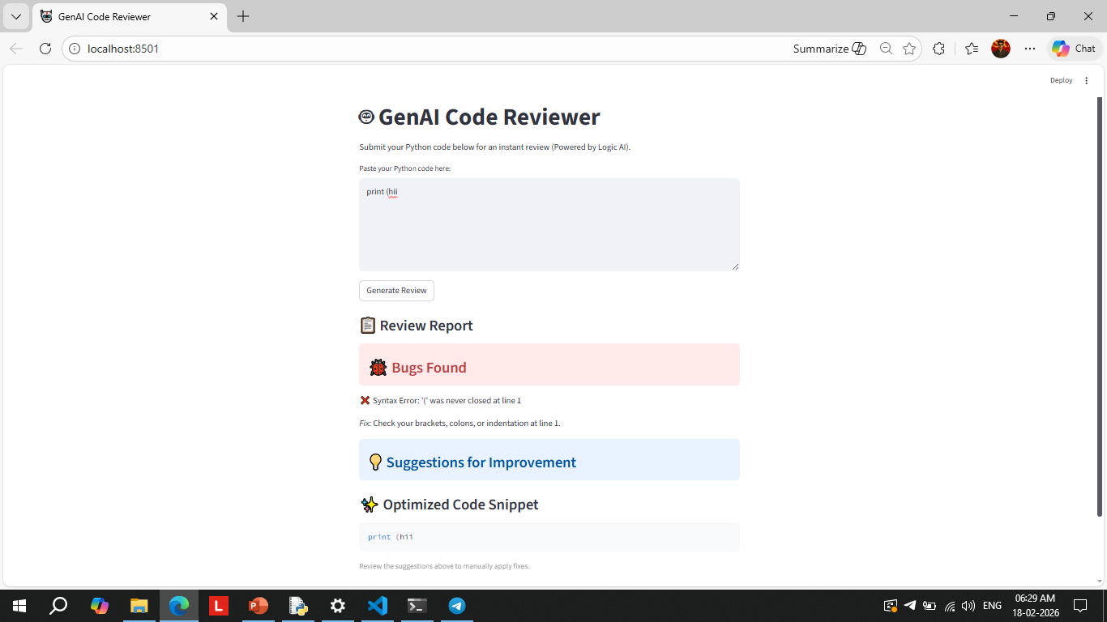
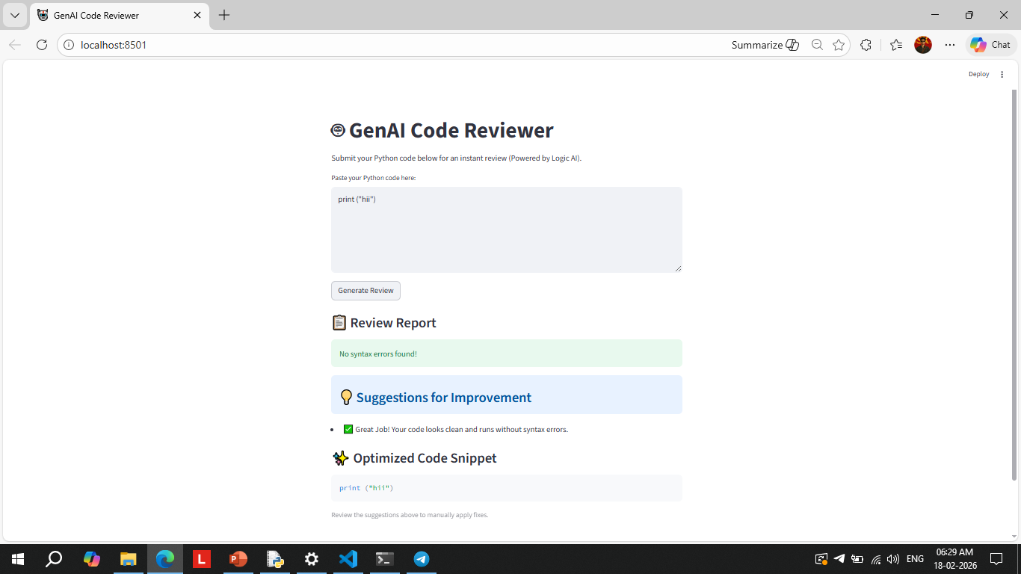
Result:
Input: The user submits a Python function containing a "Division by Zero" error and inefficient variable naming.
Output: The application displays a "Bug Detected" alert explaining the zero division risk.
Correction: A "Fixed Code" section appears below, showing the corrected function with error handling (try-except block) added.

Slide 8
Conclusion:
The GenAI Code Reviewer successfully automates the identification of bugs and code optimization, significantly reducing debugging time.The application demonstrates how Generative AI can serve as a real-time coding tutor, enhancing both productivity and code quality for developers.

Slide 9
Future scope:
Multi-Language Support: Expand the system to review code in Java, C++, JavaScript, and HTML/CSS.
IDE Plugin: Develop extensions for VS Code or PyCharm to provide real-time suggestions as the user types.
File Analysis: Implement functionality to upload and review entire project files (.py, .js) rather than single snippets.

Slide 10
References:
* OpenAI API Documentation: https://platform.openai.com/docs/
* Streamlit Framework: https://docs.streamlit.io/
* Python Software Foundation: https://www.python.org/
GitHub Link: Link

Slide 11
Thank You

